Slide 1
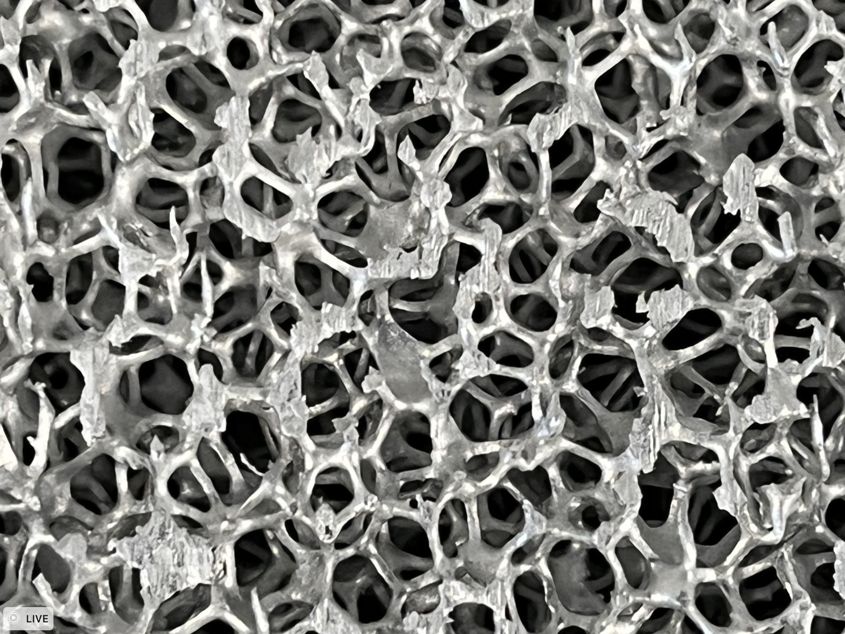
Characterization of eddy-current repulsion in conductive, non-ferromagnetic foams
TBD Project Picture
Jahnavi Sinha
Space Systems Design Studio
Cornell University
AIAA Region I Student Conference
April 1, 2023

Slide 2
Motivation
Previous research in eddy current sensing
Non-ferromagnetic aluminium commonly used
Emerging applications of metal foams due to special properties
Combining proposed actuation technology with a new material
Intro. | Problem Statement | Background | Methods | Results | Discussion | Conclusion
Notes:
Non-ferromagnetic aluminium is a commonly used material in aerospace for radiation shielding, structural purposes, etc. due to its ideal properties
Emerging applications of metal foams due to their special properties (low mass density, high mechanical strength and thermal conductivity) which could potentially lead to a decrease in launch mass
Potential interdisciplinary applications as a new material in the aerospace industry or other fields eg. thermal, materials science
Previous research has shown eddy-current sensing in foams but has not quantified the repulsion force
Aim to compare quantitative results for a solid plate and a foam

Slide 3
Problem Statement
Research Question: Demonstrate sufficient ( > 10 mN) eddy-current repulsion in foams
Start by modeling a solid aluminum plate using FEA
2. Experimentally compare repulsion force between solid plate and foam
Intro. | Problem Statement | Background | Methods | Results | Discussion | Conclusion
Notes:
Eddy-current sensing has been shown in foams before but has not quantified repulsion force on foams
Compare quantitative repulsion force results for a solid plate and for a foam

Slide 4
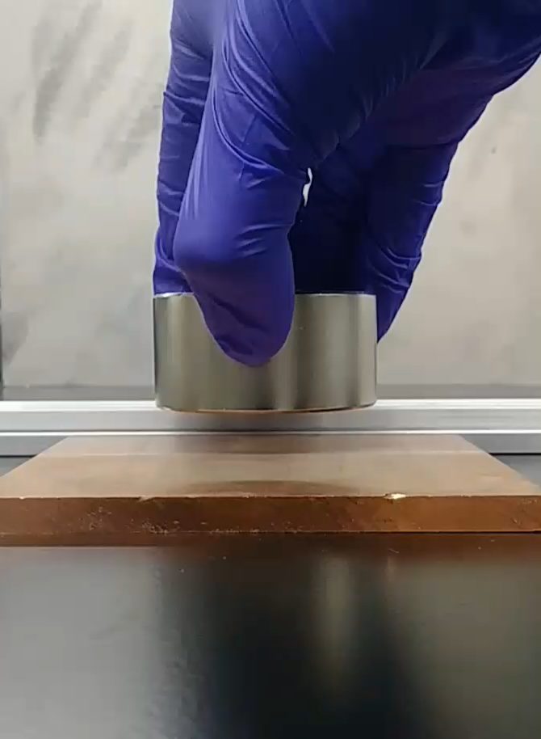
What is eddy-current actuation?
Generated in response to a changing magnetic field
Provides an opposing force to the change (Lenz’s Law)
Video courtesy of Katherine Wilson
Intro. | Problem Statement | Background | Methods | Results | Discussion | Conclusion
Notes:
To provide some background, I’ll talk about what eddy-current actuation is, describe the foam sample used in the project and then link the two
Explain what eddy current actuation is and describe what happens in the video

Slide 5
What are conductive, non-ferromagnetic foams?
Conductive: generates eddy currents
Non-ferromagnetic: no net attraction between actuator and foam
Open cell foam
Intro. | Problem Statement | Background | Methods | Results | Discussion | Conclusion
Notes:
Conductive means it that it will generate eddy currents in response to a magnetic field
Non-ferromagnetic means that there is no net attraction between the actuator and the foam
Open cell structure with interconnected pores and no membrane separating each layer of the sample (sort of like an interconnected underground cave system)

Slide 6
What are conductive, non-ferromagnetic foams?
Why foams?
Lower density than solid Al but retains high structural integrity
Lower density → lower launch mass and costs
Intro. | Problem Statement | Background | Methods | Results | Discussion | Conclusion

Slide 7
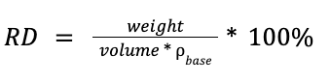
What are conductive, non-ferromagnetic foams?
Relative density: % of volume taken up by foam
Typical values: 4-12% for Al foams
Compressed to increase relative density
Intro. | Problem Statement | Background | Methods | Results | Discussion | Conclusion

Slide 8
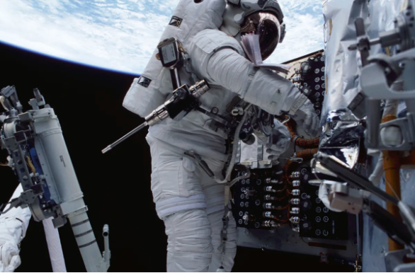
How can this be applied in the aerospace industry?
Non-contact manipulation of objects
Damping during docking
Changing attitude
Spacecraft repairs
Reduces wear on the system → longer mission lifetimes
Image courtesy of NASA
Intro. | Problem Statement | Background | Methods | Results | Discussion | Conclusion

Slide 9
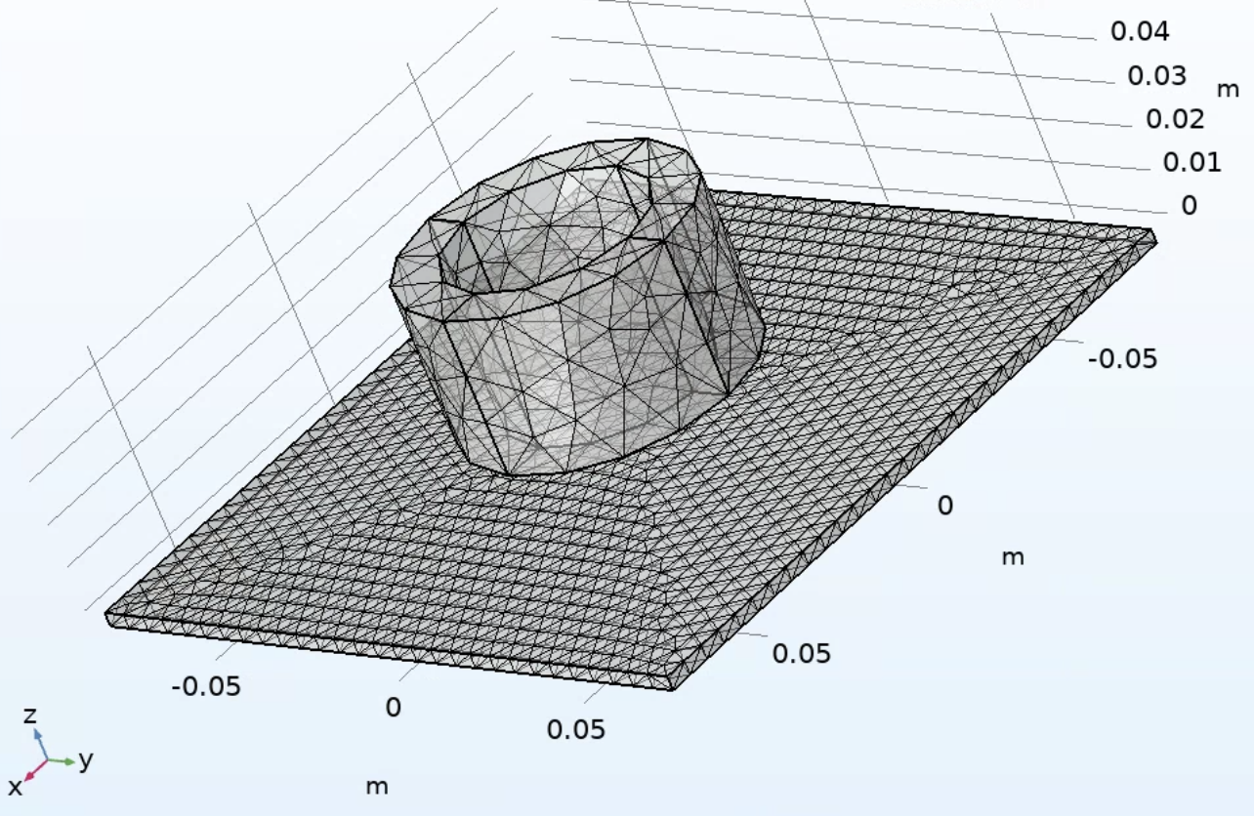
Finite Element Analysis Model
Combination of tetrahedral and free meshing
Fine mesh quality
Separation sweep from 1mm to 5cm
Intro. | Problem Statement | Background | Methods | Results | Discussion | Conclusion
Notes:
Describe meshing, degrees of freedom
Separation sweep set at constant frequency (mention separations)
1mm is contact with coil housing → defined as the point of 0mm separation in experimental trials

Slide 10
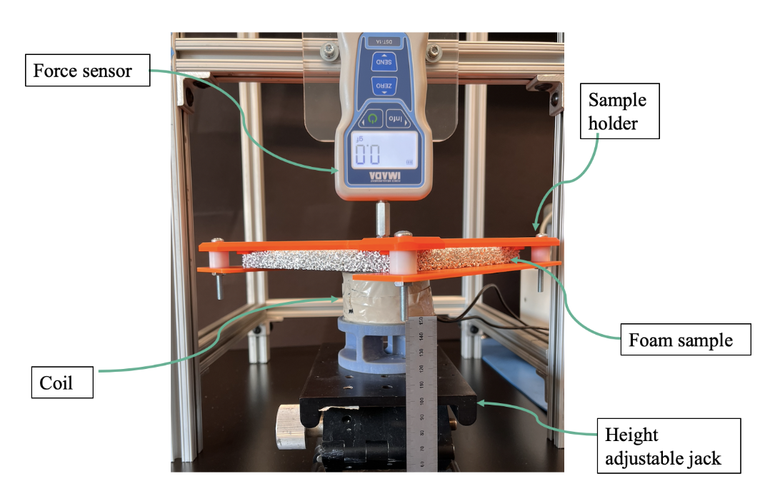
Experimental demonstration
Intro. | Problem Statement | Background | Methods | Results | Discussion | Conclusion
Notes:
Suspended force sample setup
Height adjustable jack to adjust separation between coil and foam
Force sensor reads a value of zero (point of zero separation is set as the point where the coil just touches the foam surface without triggering a change in force reading)
Sample holder attachment made using custom 3D prints

Slide 11
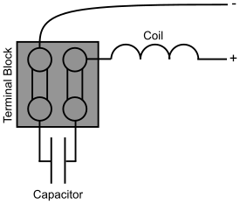
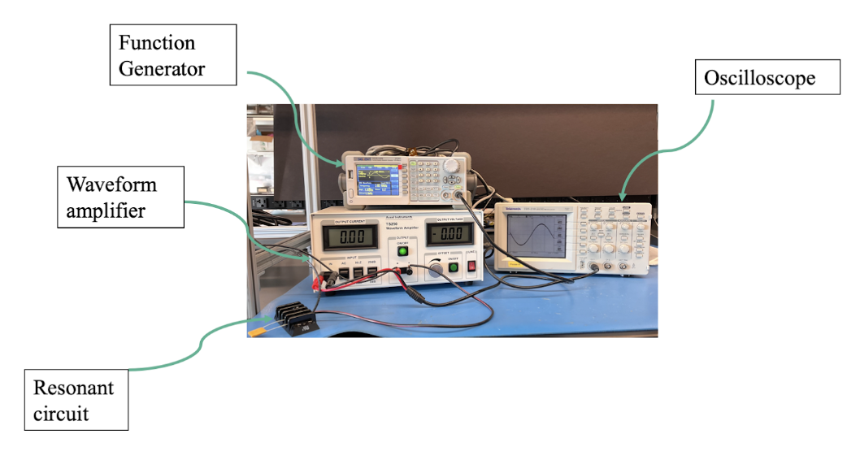
Experimental demonstration
Resonant circuit operating frequency: 1.085 kHz, 1.0 A current amplitude
Intro. | Problem Statement | Background | Methods | Results | Discussion | Conclusion
Notes:
Resonant circuit (basically an LC circuit with the coil operating as an inductor connected in parallel to a capacitor)
Involves a capacitor which has a corresponding resonant frequency
Use function generator and amplifier to set frequency and peak-to-peak voltage for AC coil operation
Oscilloscope to visualise sinusoid waveform amplitude and period
1.085 kHz frequency and 1.0 A current chosen since it shows the most stable operation without significant overheating of circuit elements

Slide 12
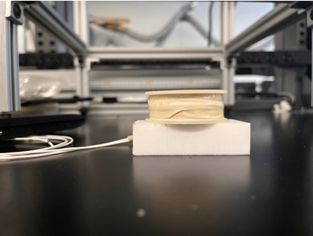
Experimental demonstration
AC coil parameters
Inner diameter | 2.7”
Outer diameter | 1.9”
Height | 1.5”
Turns | 500
Resistance | 4 Ohms
Inductance | 11.95 mH
Intro. | Problem Statement | Background | Methods | Results | Discussion | Conclusion
Notes:
Parameters of AC coil that allow it to be treated as an inductor (same parameters used in the model)

Slide 13
Experimental demonstration
Sample | Dimensions | Relative Density | Alloy
Solid Al plate | 6” x 6” x 0.08” | 100% | 6061-T6
Compressed Al foam | 6” x 6” x 0.5” | 18 - 20% | 6101-T6
Intro. | Problem Statement | Background | Methods | Results | Discussion | Conclusion
Notes:
Two types of samples used → one solid plate and one aluminium foam
Compressed foam is used to increase the relative density from typical values of between 4-12%
Compressed from original 1” height with 8-10% relative density to increase it to 18-20% relative density which we would expect to give a stronger force reading

Slide 14
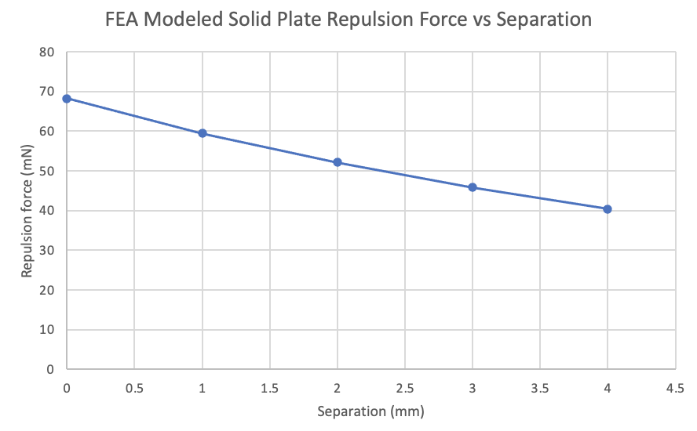
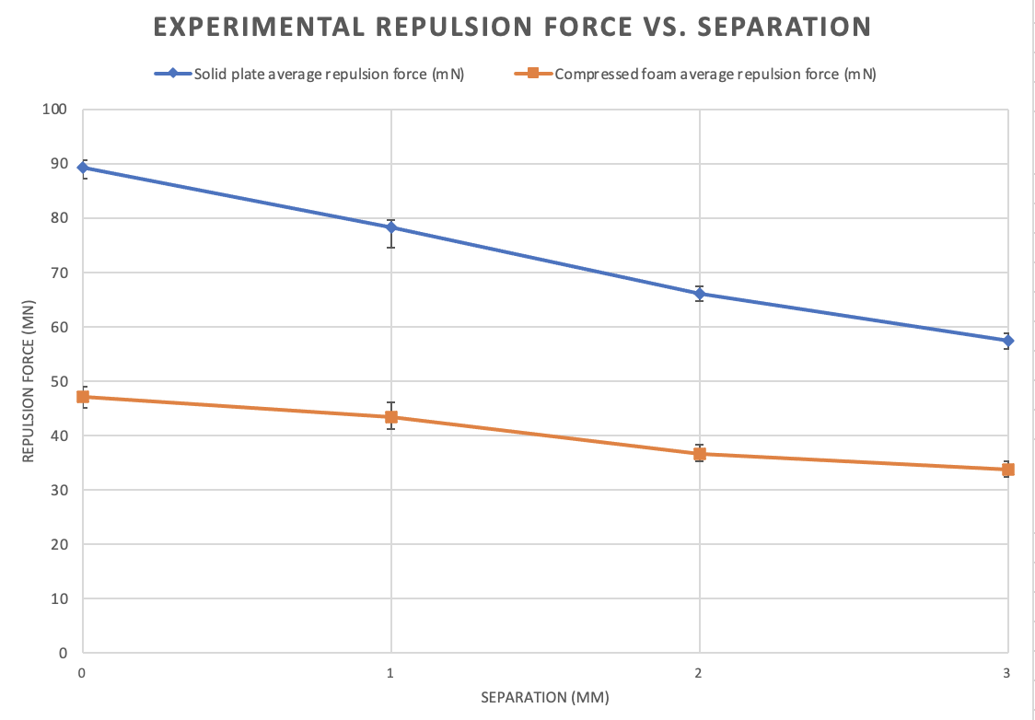
Results
Intro. | Problem Statement | Background | Methods | Results | Discussion | Conclusion
Notes:
Exponentially decaying repulsion force as separation increases (continuous line for model since it is a separation sweep)
Similar decaying behavior in experimental results, error bars indicate a deviation from the reported average value across 5 trials for each separation
Looking at the results for a solid plate, the experimental values are higher than the modelled values by a factor of 1.3
Compressed foam has an overall lower repulsion force magnitude (makes sense since it has lower relative density than the solid plate) but the results are still comparable to that of a solid plate
Suggests a non-linear relationship between relative density and repulsion force (repulsion force does decrease as relative density decreases but not as much as expected)

Slide 15
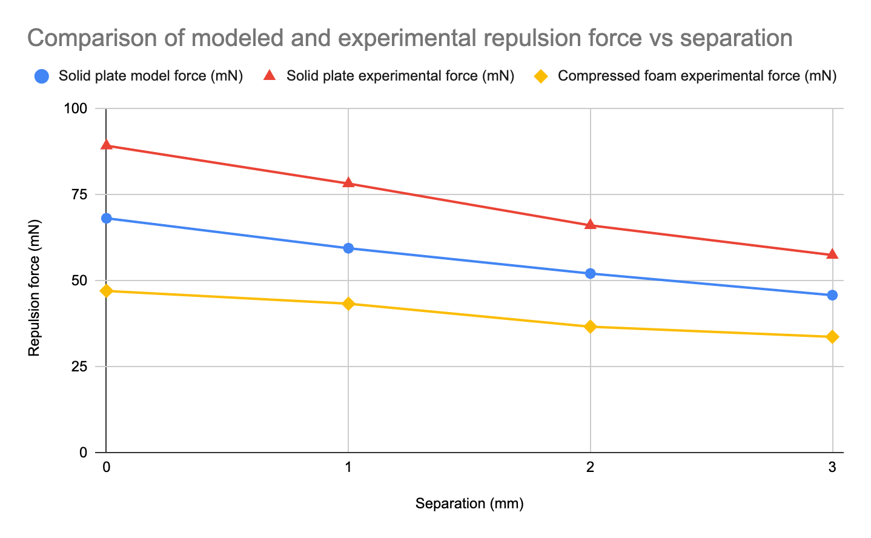
Results
Intro. | Problem Statement | Background | Methods | Results | Discussion | Conclusion
Notes:
Here is a graph overlaying all three curves → both experimental and modelled for solid plate (the two top curves) and experimental for foam

Slide 16
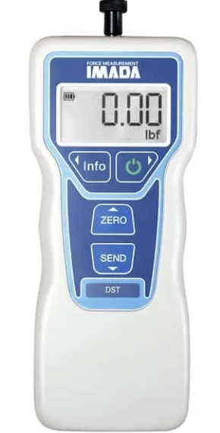
Discussion
Limitations
5N maximum load, ±1.0 g accuracy of force sensor
Deviation of model from experimental results
30% difference between modeled and experimental solid plate values
50% difference between samples
Intro. | Problem Statement | Background | Methods | Results | Discussion | Conclusion
Notes:
Limitations and sources of error
Stable operation at chosen frequency (overheating of coil, operating close to resonant frequency which could cause instability in current amplitudes, potential AC current induced vibrations at point of contact between sample and coil
Accuracy and resolution of force sensor (5N maximum load, +/- 1.0 g accuracy which means that a force reading of 19.8 mN indicates a repulsion force of at least 10 mN
Deviation of modeled results from experimental by a factor of 1.3 between solid modelled and experimental, factor of 1.8 between compressed foam and solid plate experimental

Slide 17
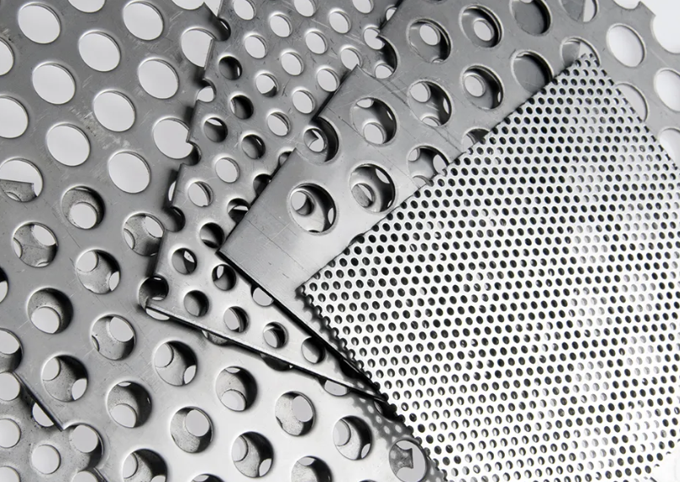
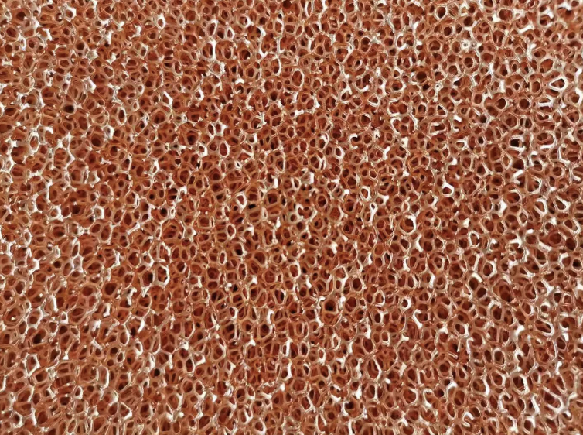
Future work
FEA refinement for solid plates, scaled conductivity model for foams
More samples with different relative densities
Perforated plates and other low density alternatives
Image courtesy of ERG Aerospace
Intro. | Problem Statement | Background | Methods | Results | Discussion | Conclusion
Notes:
Potential FEA refinement for solid plates to get to a value closer to what was experimentally measured (why was it an underestimate?)
Revisit scaled conductivity model for foams and develop a FEA model comparison with foams
Determine and quantify a relationship between relative density and repulsion force by testing with samples of different relative densities
Investigate other low-density alternatives including perforated plates and wire meshes of different materials

Slide 18
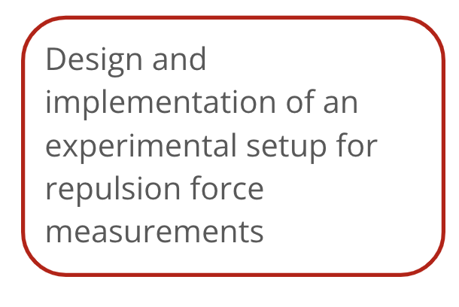
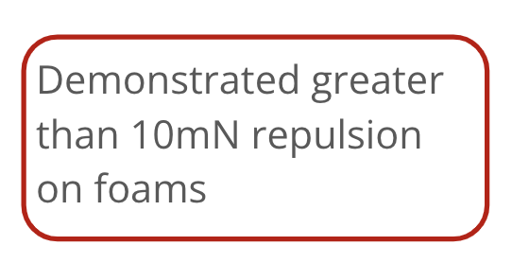
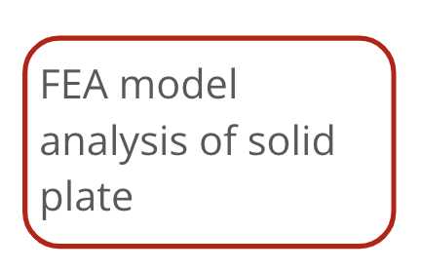
Conclusion
Intro. | Problem Statement | Background | Methods | Results | Discussion | Conclusion
Notes:
Main contributions to the project
Designed and implemented an experimental setup to take stable repulsion force measurements
Developed a FEA model and analysed it for a solid plate
Experimentally demonstrated greater than 10 mN repulsion force on foams
Further investigation may extend opportunities to reduce launch mass in space

Slide 19
References
[1] Howe, D., “Magnetic Actuators.” Sensors and Actuators A: Physical, Vol. 81, Nos. 1–3, 2000, pp. 268–274. https://doi.org/10.1016/S0924-4247(99)00174-0.
[2] Ling, S.J., Moebs, W., and Sanny, J, “Eddy Currents.” University Physics Volume 2.
[3] Wilson, K. T., Bernal, G., and Peck, M. A., “A Translating Eddy-Current Actuator for Relative Positioning of Spacecraft.” Presented at the AIAA SCITECH 2022 Forum, San Diego, CA & Virtual, 2022. https://doi.org/10.2514/6.2022-2386.
[4] Chabot, J., and Schaub, H. “Spherical Magnetic Dipole Actuator for Spacecraft Attitude Control.” Journal of Guidance, Control, and Dynamics, Vol. 39, No. 4, 2016, pp. 911–915. https://doi.org/10.2514/1.G001471.
[5] Reinhardt, B. Z., and Peck, M. A. “New Electromagnetic Actuator for On-Orbit Inspection.” Journal of Spacecraft and Rockets, Vol. 53, No. 2, 2016, pp. 241–248. https://doi.org/10.2514/1.A33320.
[6] Ma, X. and Peyton, A.J., “Eddy Current Measurement of the Electrical Conductivity and Porosity of Metal Foams.” IEEE Transactions on Instrumentation and Measurement, Vol. 55, No. 2, 2006, pp. 570–576. https://doi.org/10.1016/S0924-4247(99)00174-0.
[7] COMSOL, AC/DC module, Software Package, Ver. 5.6
[8] Wilson, K. T., and Peck, M. A., “Electromagnetic, Free-Flying Mobility Relative to a Conductive Body.” Presented at the AIAA Scitech 2020 Forum, Orlando, FL, 2020. https://doi.org/10.2514/6.2020-1458

Slide 20
Acknowledgements
This work would like to acknowledge the technical mentorship of Katherine Wilson and and Dr. Mason Peck of the Cornell University Sibley School of Mechanical and Aerospace Engineering. A Cornell University Engineering Learning Initiatives grant supported this work.
Intro. | Problem Statement | Background | Methods | Results | Discussion | Conclusion

Slide 21
Conclusion
Design and implementation of an experimental setup for repulsion force measurements
FEA model analysis of solid plate
Demonstrated greater than 10mN repulsion on foams
Intro. | Problem Statement | Background | Methods | Results | Discussion | Conclusion
Notes:
Main contributions to the project
Designed and implemented an experimental setup to take stable repulsion force measurements
Developed a FEA model and analysed it for a solid plate
Experimentally demonstrated greater than 10 mN repulsion force on foams

Slide 22
Supplement
Notes:
Include any additional details, especially equations, assumptions, etc. after this slide

Slide 23
BACKUP - results in table format
Separation (mm) | Solid plate model force (mN) | Solid plate experimental force (mN) | Compressed foam experimental force (mN)
0 | 68.19 | 89.27 | 47.09
1 | 59.49 | 78.28 | 43.36
2 | 52.14 | 66.12 | 36.69
3 | 45.85 | 57.49 | 33.75

Slide 24
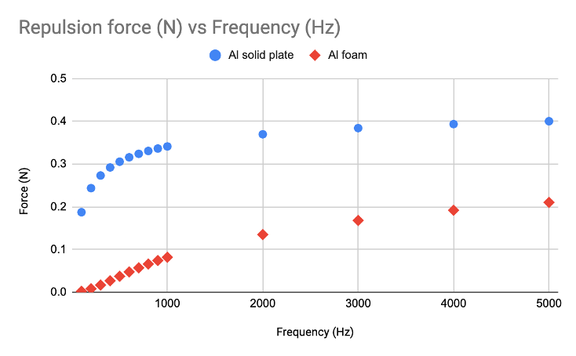
BACKUP - show preliminary frequency sweep results

Slide 25
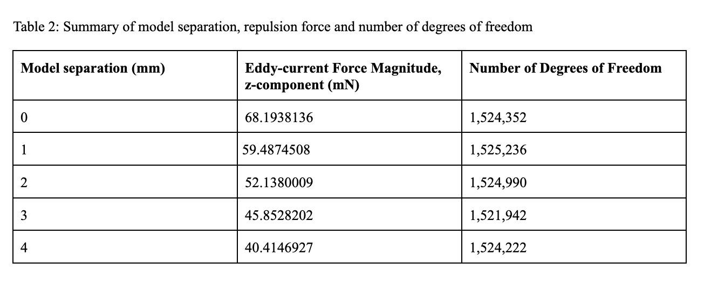
BACKUP - FEA model degrees of freedom

Slide 26
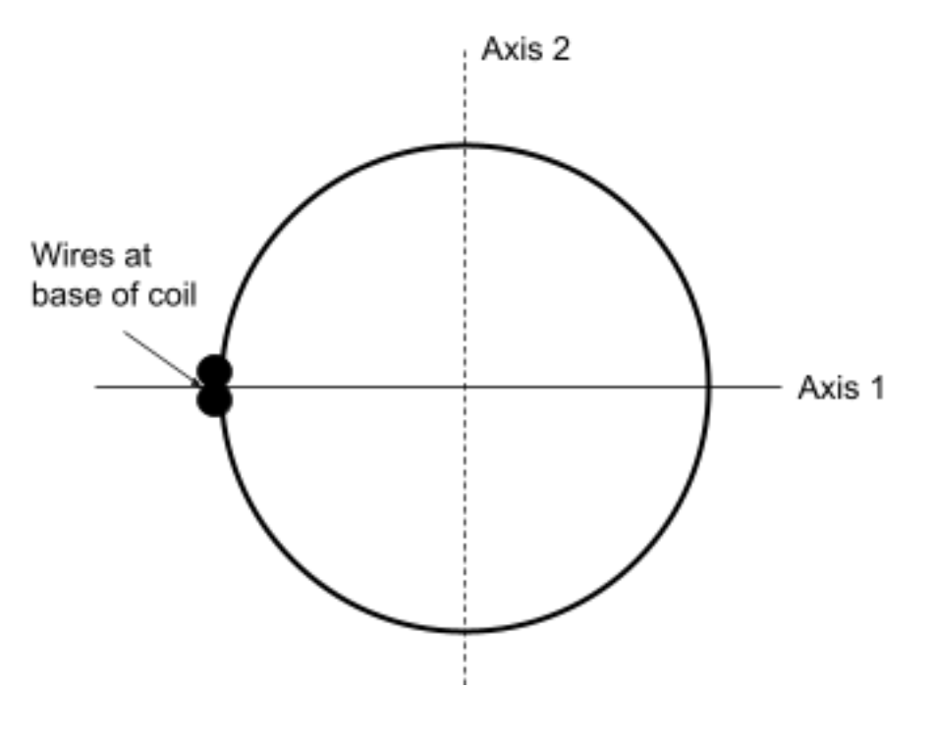
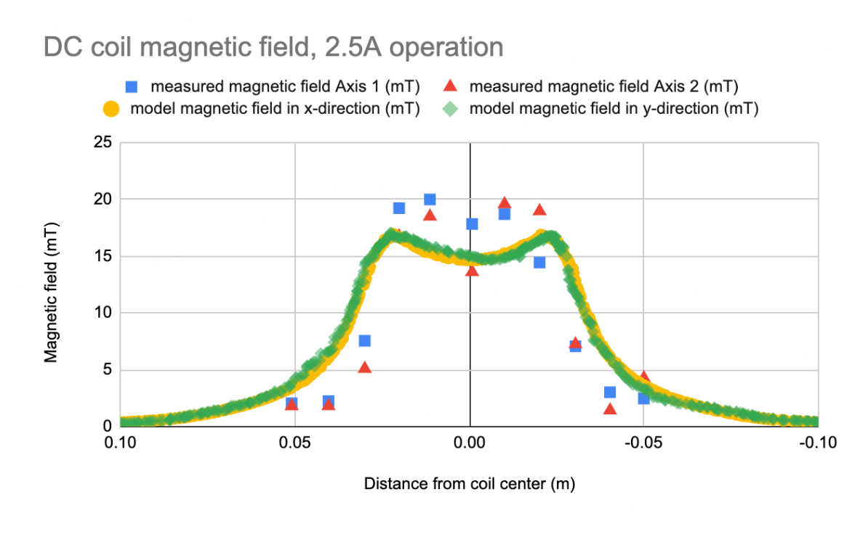
BACKUP - coil magnetic field measurements

